Slide 1
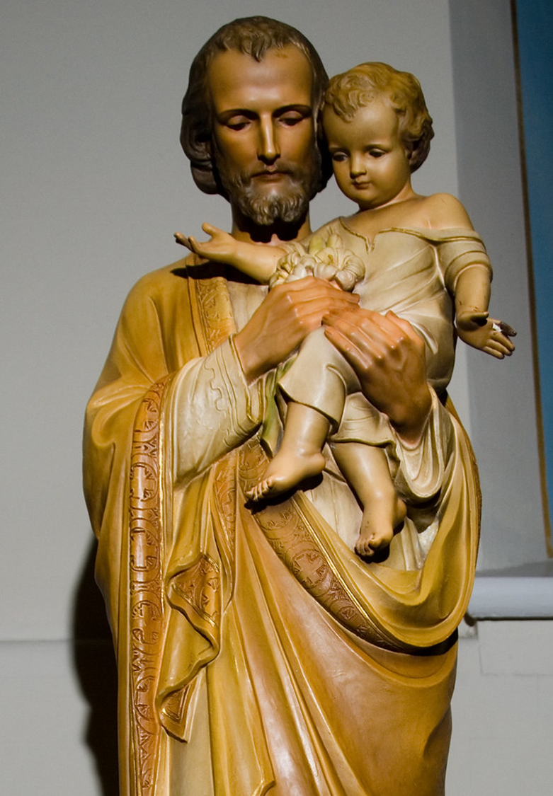
St. Joseph
Men’s Lenten Retreat
St. Regis Parish

Slide 2
Opening prayer to St. Joseph (composed by St. Francis de sales)
Glorious St. Joseph, spouse of the Virgin Mary, we beseech you through the Heart of Jesus Christ, grant to us your fatherly protection.
O you whose power reaches all our necessities and who knows how to make possible the most impossible things, open your fatherly eyes to the needs of your children. In the confusion and pain which press upon us, we have recourse to you with confidence. Deign to take beneath your charitable guidance this important and difficult affair, the cause of our worries, and make that its happy outcome serve for the glory of God and the good of his devoted servants. Amen.

Slide 3
Why Focus on St. Joseph?
As men, we need men as role models
Good fathers are essential
St. Joseph was head of the Holy Family
Model of protection
His protection is needed!
His time has come to take a more prominent role

Slide 4
Timeline of increased focus on St. Joseph
1870 – declared Patron of the Universal Church
Pontificate of St. John XXIII – name put in Roman Canon
2013 – insertion of his name into all other Eucharistic prayers
2020 – a “Year of St. Joseph”
2020 – Patris Corde (With a Father’s Heart) apostolic letter

Slide 5
Ways Pope Francis Describes St. Joseph’s Fatherhood:
BELOVED
TENDER and LOVING
OBEDIENT
ACCEPTING
CREATIVELY COURAGEOUS
WORKING
IN THE SHADOWS

Slide 6
Consecration to St. JOseph
When God wishes to raise a soul to greater heights, he unites it to St. Joseph by giving it a strong love for the good saint.
-St. Peter Julian Eymard

Slide 7
St. Joseph in Sacred Scripture

Slide 8
The Annunciation of St. Joseph (Matthew 1:18-25)
Now the birth of Jesus the Messiah took place in this way. When his mother Mary had been engaged to Joseph, but before they lived together, she was found to be with child from the Holy Spirit. Her husband Joseph, being a righteous man and unwilling to expose her to public disgrace, planned to dismiss her quietly. But just when he had resolved to do this, an angel of the Lord appeared to him in a dream and said, “Joseph, son of David, do not be afraid to take Mary as your wife, for the child conceived in her is from the Holy Spirit. She will bear a son, and you are to name him Jesus, for he will save his people form their sins.” All this took place to fulfill what had been spoken by the Lord through the prophet: “Look, the virgin shall conceive and bear a son, and they shall name him Emmanuel,” which means “God is with us”. When Joseph awoke from sleep, he did as the angel of the Lord commanded him; he took her as his wife, but had no marital relations with her until she had borne a son, and he named him Jesus.

Slide 9
The Commands of the angel of the Lord (Matthew 2:13-14; 19-21)
And after they had gone away, behold, an Angel of the Lord appeared in sleep to Joseph, saying: “Rise up, and take the boy and his mother, and flee into Egypt. And remain there until I tell you. For it will happen that Herod will seek the boy to destroy him.” And getting up, he took the boy and his mother by night, and withdrew into Egypt. Then, when Herod had passed away, behold, an Angel of the Lord appeared in sleep to Joseph in Egypt, saying: “Rise up, and take the boy and his mother, and go into the land of Israel. For those who were seeking the life of the boy have passed away.” And rising up, he took the boy and his mother, and he went into the land of Israel.

Slide 10
The Litany of St. Joseph
Lord, have mercy .[Lord, have mercy.]
Christ, have mercy. [Christ, have mercy.]
Lord, have mercy. [Lord, have mercy.]
Christ, hear us. [Christ, graciously hear us.]
God, the Father of Heaven, [have mercy on us.]
God the Son, Redeemer of the world, [have mercy on us.]
God the Holy Spirit, [have mercy on us.]

Slide 11
The Litany of St. Joseph
Holy Trinity, One God, [have mercy on us.]
Holy Mary, [pray for us.]
Saint Joseph, [pray for us.]
Noble Offspring of David, [pray for us.]
Light of Patriarchs, [pray for us.]
Spouse of the Mother of God, [pray for us.]
Chaste Guardian of the Virgin, [pray for us.]

Slide 12
The Litany of St. Joseph
Foster-Father of the Son of God, [pray for us.]
Zealous Defender of Christ, [pray for us.]
Head of the Holy Family, [pray for us.]
Joseph, Most Just, [pray for us.]
Joseph, Most Chaste, [pray for us.]
Joseph, Most Prudent, [pray for us.]
Joseph, Most Courageous, [pray for us.]

Slide 13
The Litany of St. Joseph
Joseph, Most Obedient, [pray for us.]
Joseph, Most Faithful, [pray for us.]
Mirror of Patience, [pray for us.]
Lover of Poverty, [pray for us.]
Model of Workmen, [pray for us.]
Glory of Domestic Life, [pray for us.]
Guardian of Virgins, [pray for us.]

Slide 14
The Litany of St. Joseph
Pillar of Families, [pray for us.]
Comfort of the Afflicted, [pray for us.]
Hope of the Sick, [pray for us.]
Patron of the Dying, [pray for us.]
Terror of Demons, [pray for us.]
Protector of the Holy Church, [pray for us.]
Lamb of God, who takes away the sins of the world, [Spare us, O Lord.]

Slide 15
The Litany of St. Joseph
Lamb of God, who takes away the sins of the world, [Graciously hear us, O Lord.]
Lamb of God, who takes away the sins of the world, [have mercy on us.]
He has made him lord of his household, [and prince over all his possessions.]
Let us pray. O God, who in your loving providence chose Blessed Joseph to be the spouse of your most Holy Mother, grant us the favor of having him for our intercessor in heaven whom on earth we venerate as our protector. You, who live and reign forever and ever. [Amen.]

Slide 16
The Litany of St. Joseph
Lamb of God, who takes away the sins of the world, [Graciously hear us, O Lord.]
Lamb of God, who takes away the sins of the world, [have mercy on us.]
He has made him lord of his household, [and prince over all his possessions.]
Let us pray. O God, who in your loving providence chose Blessed Joseph to be the spouse of your most Holy Mother, grant us the favor of having him for our intercessor in heaven whom on earth we venerate as our protector. You, who live and reign forever and ever. [Amen.]

Slide 17
Virtues of St. Joseph
“Most Chaste”
“Most Prudent”
“Lover of Poverty”
“Model of Workmen”
“Mirror of Patience”
“Comfort of the Afflicted”
“Most Obedient”
CHASTITY > lust
TEMPERANCE > gluttony
CHARITY > greed
DILIGENCE > sloth
PATIENCE > wrath
KINDNESS > envy
HUMILITY > pride

Slide 18
Terror of Demons
It is a great blessing for souls to be under the protection of the saint whose name makes demons tremble and fear.
-Blessed Bartolo Longo

Slide 19
Terror of Demons

Slide 20
RESOURCES
https://www.usccb.org/saint-joseph
https://www.vaticannews.va/en/vatican-city/news/2020-12/apostolic-penitentiary-plenary-indulgence-year-st-joseph.html
Consecration to St. Joseph: The Wonders of Our Spiritual Fathers by Fr. Donald Calloway, MIC

Slide 21
The Litany of St. Joseph
Lord, have mercy .[Lord, have mercy.]
Christ, have mercy. [Christ, have mercy.]
Lord, have mercy. [Lord, have mercy.]
Christ, hear us. [Christ, graciously hear us.]
God, the Father of Heaven, [have mercy on us.]
God the Son, Redeemer of the world, [have mercy on us.]
God the Holy Spirit, [have mercy on us.]

Slide 22
The Litany of St. Joseph
Holy Trinity, One God, [have mercy on us.]
Holy Mary, [pray for us.]
Saint Joseph, [pray for us.]
Noble Offspring of David, [pray for us.]
Light of Patriarchs, [pray for us.]
Spouse of the Mother of God, [pray for us.]
Chaste Guardian of the Virgin, [pray for us.]

Slide 23
The Litany of St. Joseph
Foster-Father of the Son of God, [pray for us.]
Zealous Defender of Christ, [pray for us.]
Head of the Holy Family, [pray for us.]
Joseph, Most Just, [pray for us.]
Joseph, Most Chaste, [pray for us.]
Joseph, Most Prudent, [pray for us.]
Joseph, Most Courageous, [pray for us.]

Slide 24
The Litany of St. Joseph
Joseph, Most Obedient, [pray for us.]
Joseph, Most Faithful, [pray for us.]
Mirror of Patience, [pray for us.]
Lover of Poverty, [pray for us.]
Model of Workmen, [pray for us.]
Glory of Domestic Life, [pray for us.]
Guardian of Virgins, [pray for us.]

Slide 25
The Litany of St. Joseph
Pillar of Families, [pray for us.]
Comfort of the Afflicted, [pray for us.]
Hope of the Sick, [pray for us.]
Patron of the Dying, [pray for us.]
Terror of Demons, [pray for us.]
Protector of the Holy Church, [pray for us.]
Lamb of God, who takes away the sins of the world, [Spare us, O Lord.]

Slide 26
The Litany of St. Joseph
Lamb of God, who takes away the sins of the world, [Graciously hear us, O Lord.]
Lamb of God, who takes away the sins of the world, [have mercy on us.]
He has made him lord of his household, [and prince over all his possessions.]
Let us pray. O God, who in your loving providence chose Blessed Joseph to be the spouse of your most Holy Mother, grant us the favor of having him for our intercessor in heaven whom on earth we venerate as our protector. You, who live and reign forever and ever. [Amen.]

Slide 27
The Litany of St. Joseph
Lamb of God, who takes away the sins of the world, [Graciously hear us, O Lord.]
Lamb of God, who takes away the sins of the world, [have mercy on us.]
He has made him lord of his household, [and prince over all his possessions.]
Let us pray. O God, who in your loving providence chose Blessed Joseph to be the spouse of your most Holy Mother, grant us the favor of having him for our intercessor in heaven whom on earth we venerate as our protector. You, who live and reign forever and ever. [Amen.]

Slide 28
Discussion Questions
Which aspect(s) of the fatherhood of St. Joseph (refer to the seven listed by Pope Francis) do I look forward to as I claim St. Joseph as my spiritual father?
What do we know about the character of St. Joseph based on his encounters with the angel of the Lord?
Which virtues of St. Joseph do I seek to emulate in my own life?
Which titles of St. Joseph found in the Litany to St. Joseph do I find inspiring to me?
How will consecrating myself to St. Joseph help me grow in holiness and my relationship with Jesus?

